Slide 1


A PROJECT REPORT ON “HOMECARE CLEANING SYSTEM”
Presented By-
Mr. Akash Rathod
Mr. Shekhar Shelke
Miss. Aditi Ohol
Under The guidance of
Mrs. Kiran Tiwari Ma’am
HOMECARE CLEANING SYSTEM

Slide 2

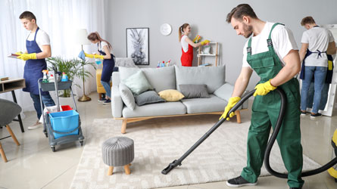
CONTEXT
Aim of project
Implementation plan
Objectives
ER-Diagram
Entities
Backend Architecture
Demo
Future Scopes
Conclusion
HOMECARE CLEANING SYSTEM

Slide 3
Aim Of Project
The goal of the "Homecare Cleaning Service System" project is to build a user-friendly online platform for booking home cleaning services. Customers can easily schedule appointments, manage bookings, give feedback, and make payments online. This system aims to simplify the booking process and enhance customer satisfaction by providing efficient service management.
HOMECARE CLEANING SYSTEM

Slide 4
Implementation And Plan
Development: Implement front-end using HTML/CSS for layout and JavaScript for interactive elements. Develop back-end logic using Java to handle booking scheduling, user authentication, and data management. Set up database using MySQL or similar to store and retrieve customer data, booking information, etc.
Testing: Conduct unit testing to ensure each component functions correctly. Perform integration testing to verify interactions between front-end, back-end, and database. Test user flows to ensure smooth navigation and functionality across different devices and browsers.
Deployment: Deploy the system on a web server that supports Java applications and MySQL databases. Configure security measures such as HTTPS, encryption for sensitive data, and user authentication.
HOMECARE CLEANING SYSTEM

Slide 5

Objectives
Book cleaning appointments online for convenience and ease of access.
View transparent pricing and service details before scheduling.
Manage bookings efficiently through a user-friendly interface.
Secure online payments ensure hassle-free transactions for customers.
Enhance customer satisfaction with reliable service and support.
HOMECARE CLEANING SYSTEM

Slide 6
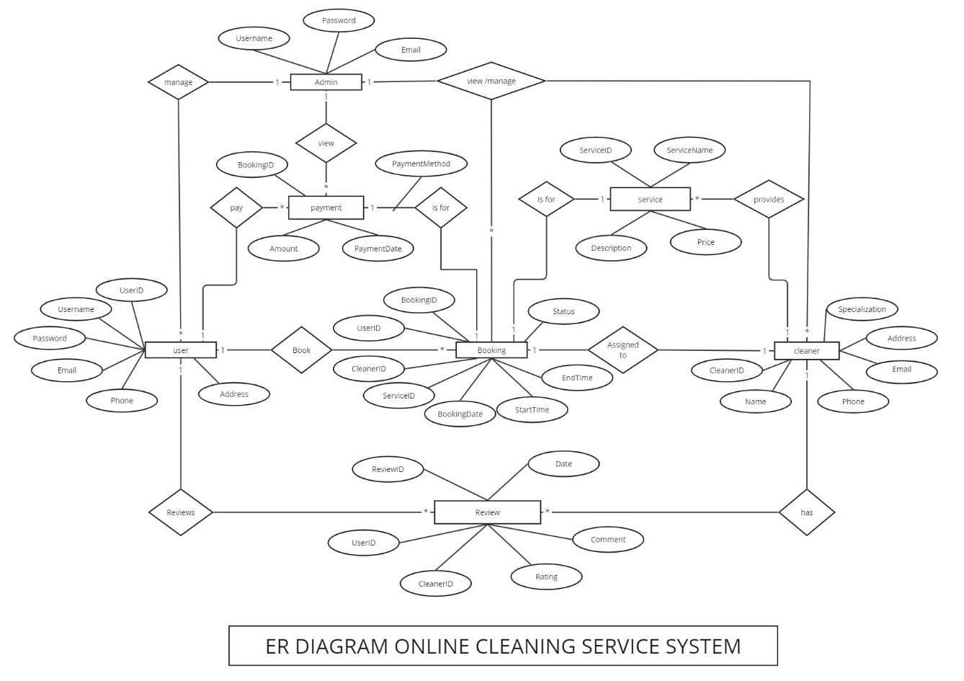
ER Diagram

Slide 7
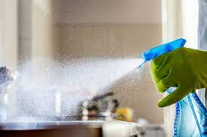
Entities
Entities
Admin
Booking
Customer
cleaner
Payment
Review
Service
HOMECARE CLEANING SYSTEM

Slide 8
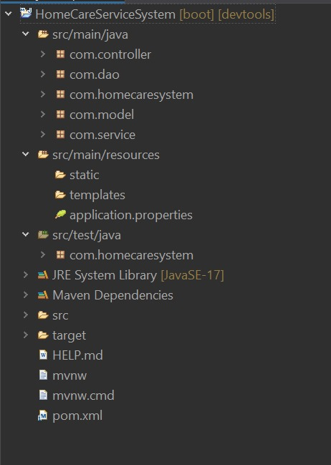
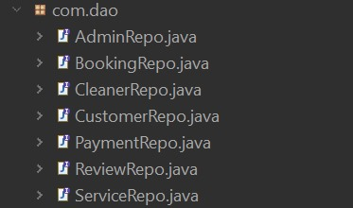
BACKEND ARCHITETUR : (MYSQL)
Body of Project
Dao/Repository Package
HOMECARE CLEANING SYSTEM

Slide 9
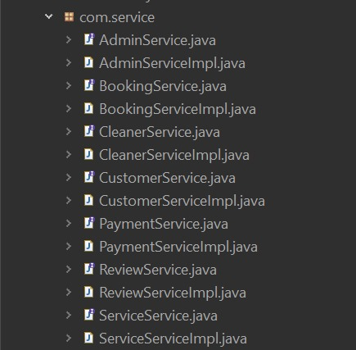
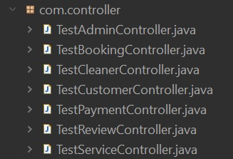
Service Package
Controller Package
HOMECARE CLEANING SYSTEM

Slide 10
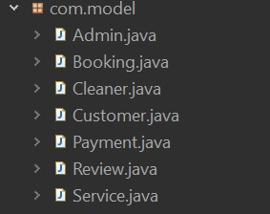
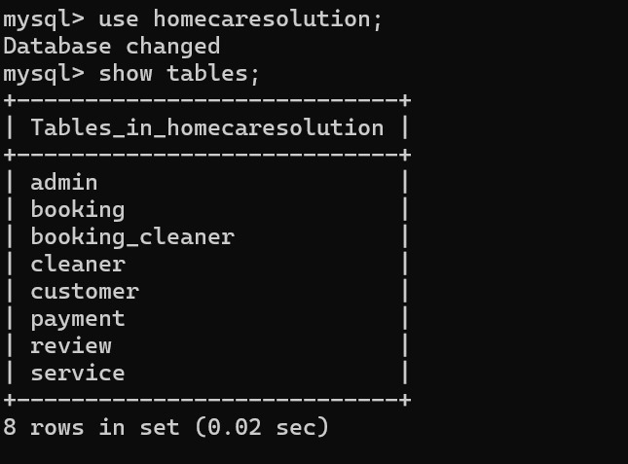
Model Package
Tables
HOMECARE CLEANING SYSTEM

Slide 11
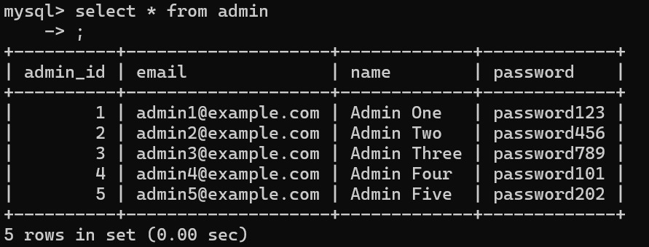
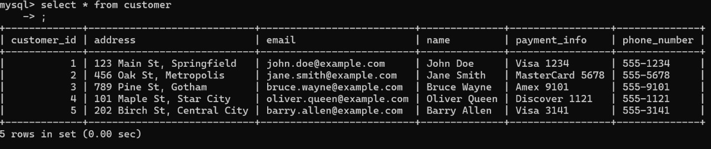
Admin Table
Customer Table

Slide 12
Future Scopes
Expansion of Services: Introducing additional cleaning services such as deep cleaning, specialized treatments (e.g., carpet cleaning, window cleaning), and seasonal services.
Mobile Application: Developing a mobile app version for iOS and Android platforms to enhance accessibility and convenience for customers on-the-go.
Integration with Smart Devices: Integrating with smart home devices (e.g., IoT sensors, smart locks) to automate scheduling and improve service efficiency.
Enhanced Customer Engagement: Implementing features like real-time service tracking, personalized recommendations based on past bookings, and loyalty programs to increase customer retention.
HOMECARE CLEANING SYSTEM

Slide 13
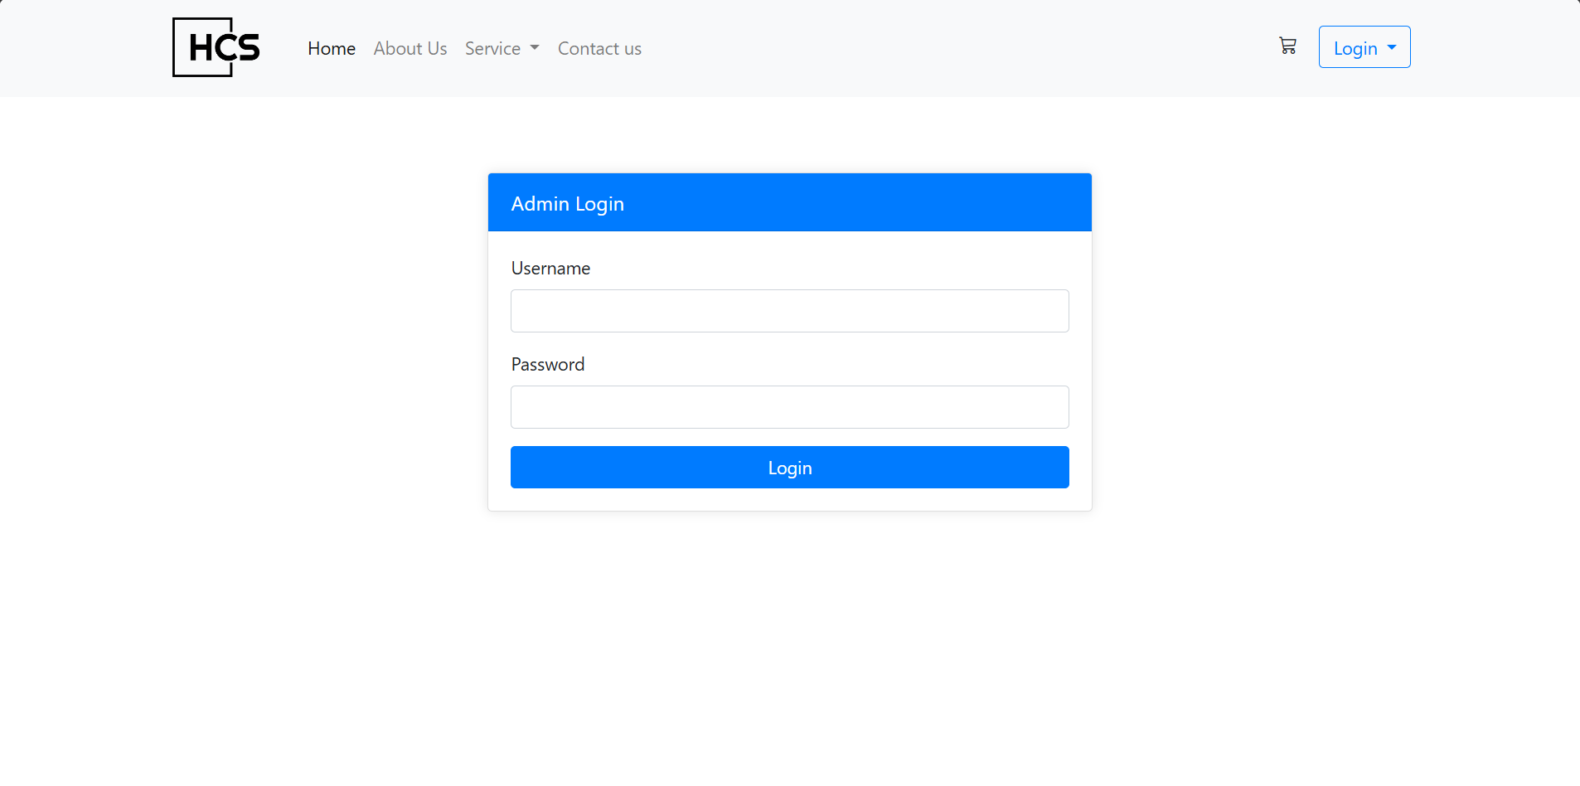
Admin login

Slide 14
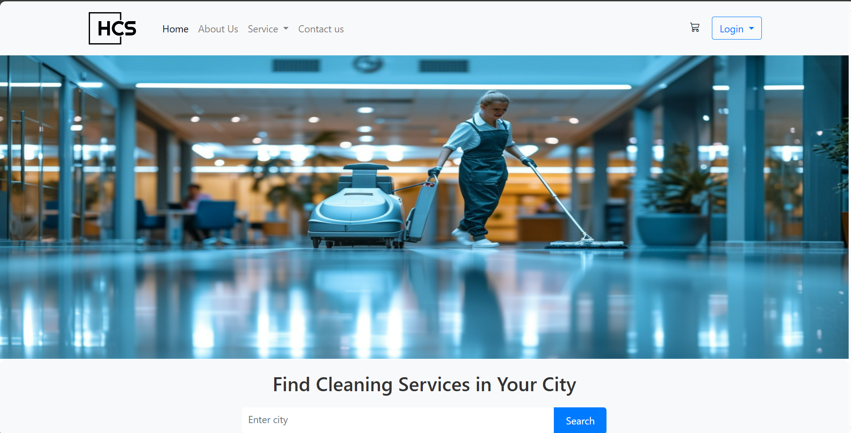
Home Page

Slide 15
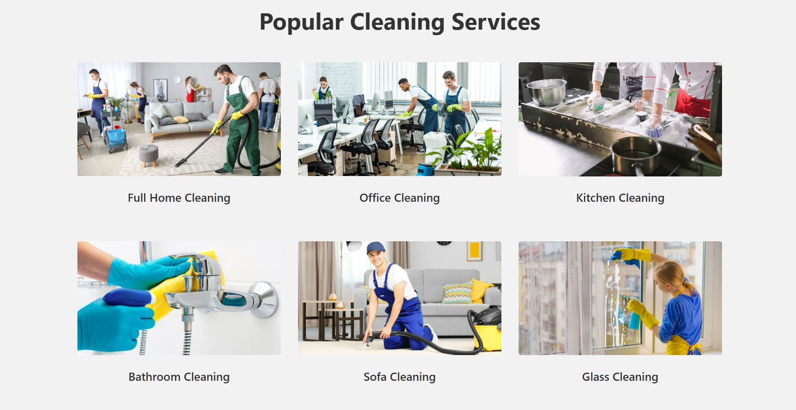
Popular service

Slide 16
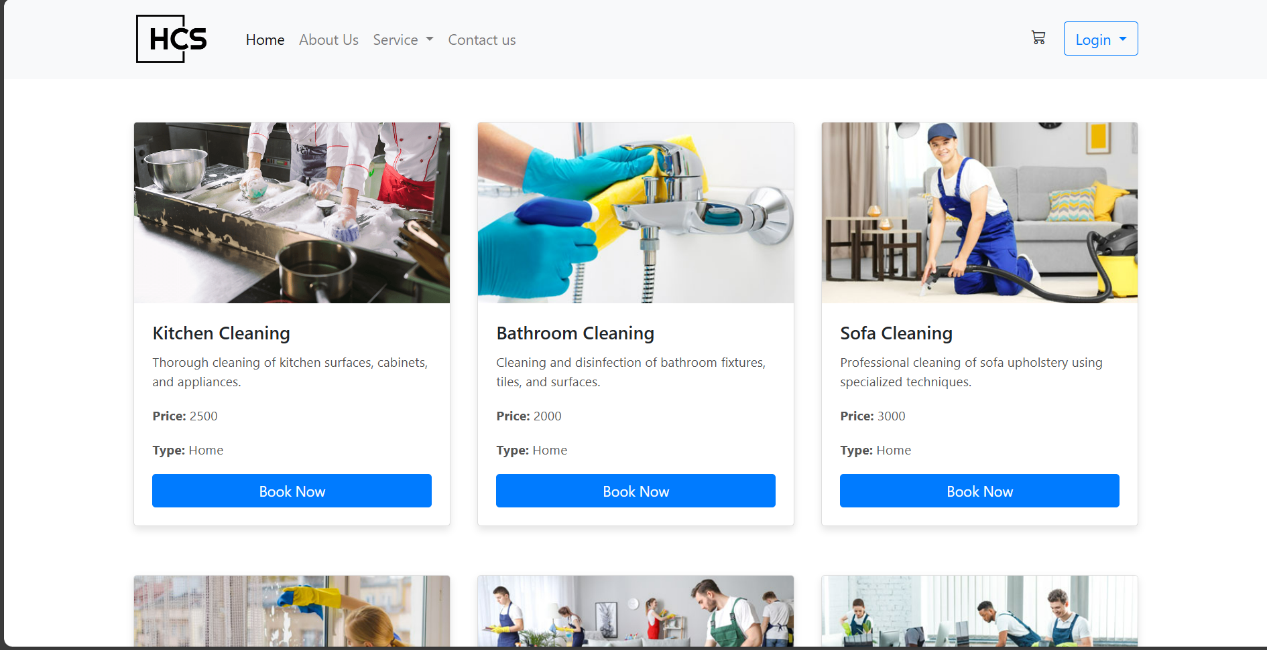
services

Slide 17
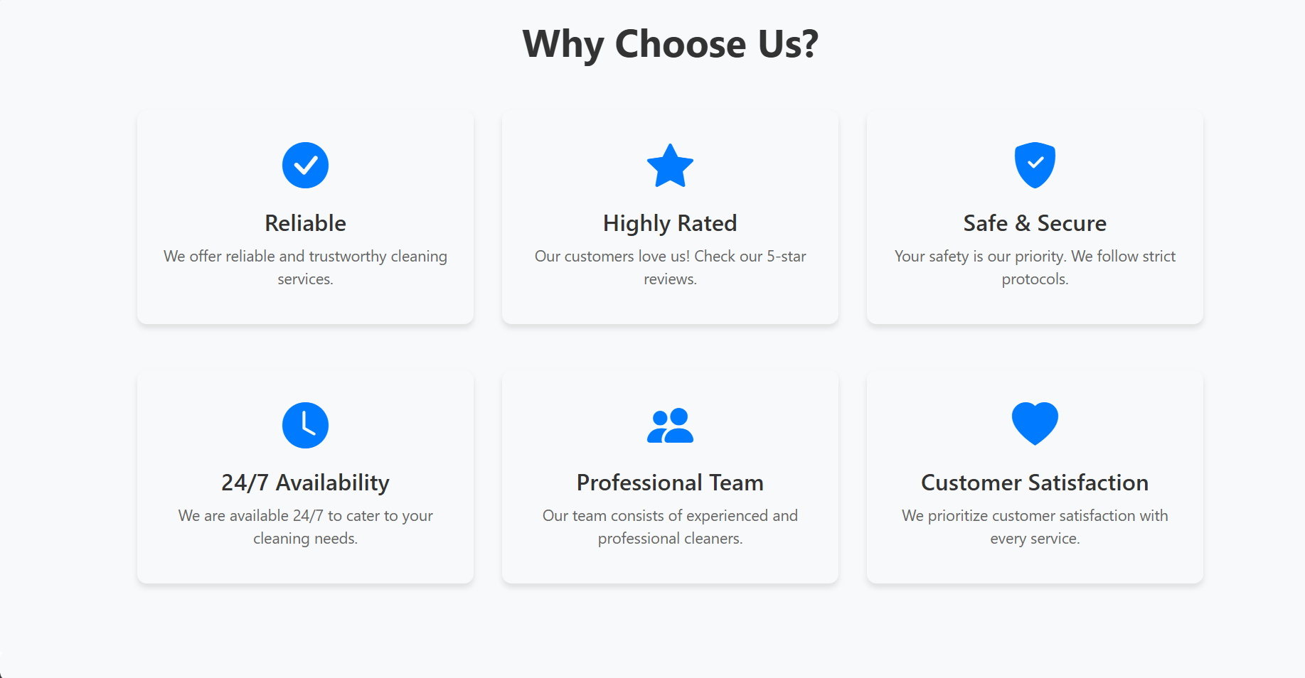
Why Choose Us?

Slide 18
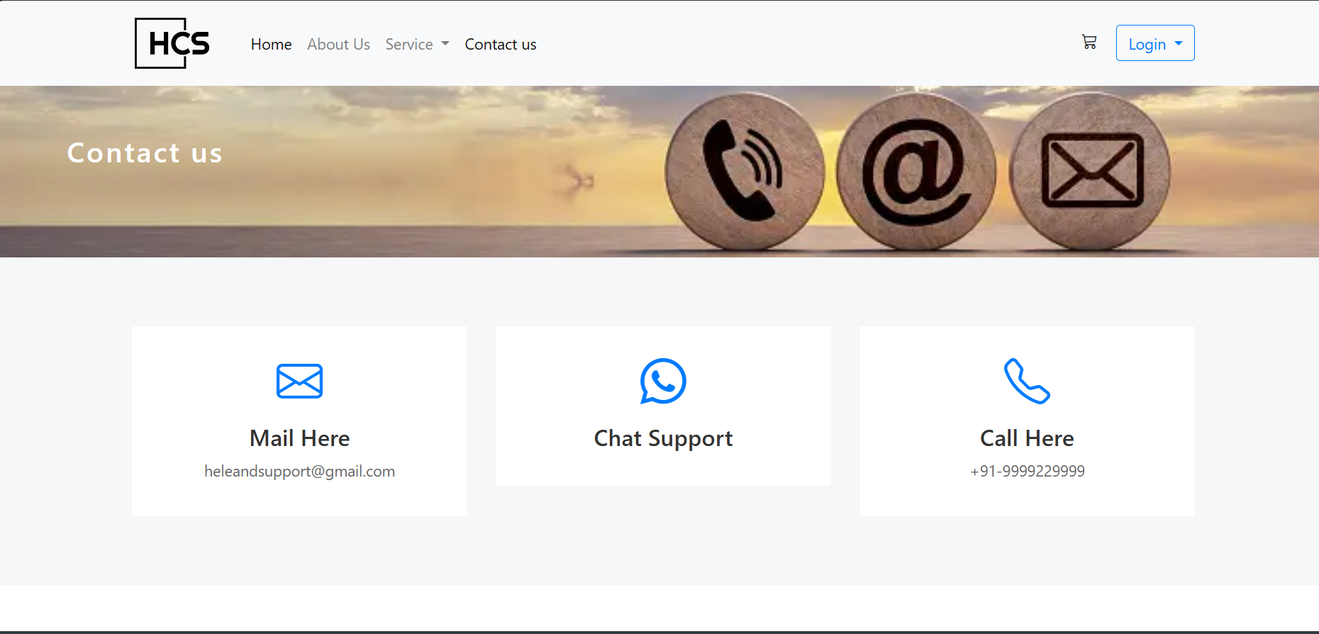
Contact us

Slide 19
Conclusion
Maintaining high standards of cleanliness and housekeeping is an on-going and never ending jobs, and will only happen if we have a detailed schedule of the tasks that need to be done, a clearly room status and best room cleaning procedure. Not just that, they have a to alert on room inspections and reports. As a conclusion, every staff has to understand the importance of maintaining these high standard speech and every day
HOMECARE CLEANING SYSTEM

Slide 20
THANK YOU !!

